Slide 1
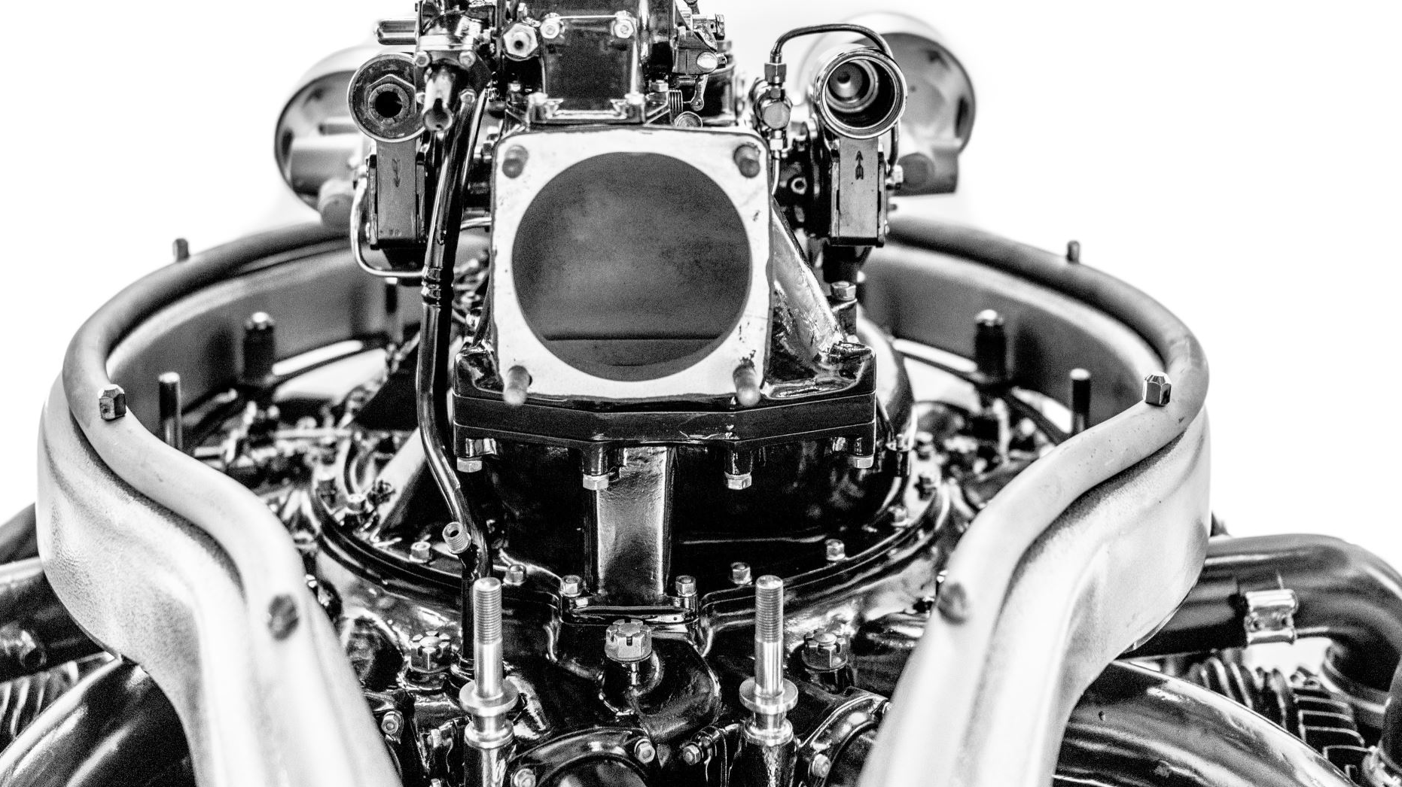
Recommendation Engine Overview
Understanding the Process and Implementation
Presented by: Daksh Bhardwaj

Slide 2
Introduction to the Recommendation Engine
• Purpose: Automate content recommendations to users based on popularity and recency.
• Key Features:
- Recommends popular items and recent posts.
- Detects new users and generates recommendations accordingly.
- Configurable via external config.ini file.

Slide 3
Configuration and Initialization
• Config File (config.ini):
- InputFile: Location of the input dataset.
- UsernamesFile: CSV containing usernames.
- OutputFile: File to store general recommendations.
- RecommendationsOutputFile: File to store user-specific recommendations.
- TopN, SleepTime: Number of recommendations and delay between checks.
- Weights: Importance of each field like view count, rating count, etc.
• Logging:
- Tracks the flow and errors in recommendation_engine.log.

Slide 4
Loading Data
• load_data() Function:
- Loads and processes the main dataset from InputFile.
• load_usernames() Function:
- Loads usernames from UsernamesFile for user-specific recommendations.

Slide 5
Core Recommendation Logic
• Popularity Score Calculation:
- Formula: Weighted sum of view count, rating count, upvote count, share count, and comment count.
- Normalization: Ensures weights sum to 1.
• Sorting Items:
- Popular Items: Sorted by popularity score.
- Recent Items: Sorted by creation date (created_at_scaled).
• Recommendation Logic:
- Generates batches of 4 popular and 1 recent item.
- Up to 50 items recommended to each user.

Slide 6
New User Detection and Processing
• New Users Identification:
- Identifies users without prior history by checking usernames_data.
• Custom Recommendations:
- Recommendations saved specifically for new users in RecommendationsOutputFile.
- Recommendations are presented in a loop until all users are processed.

Slide 7
Running the Recommendation Engine
• run_recommendation_engine() Function:
- Continuously checks for new users.
- Restarts the recommendation process if new users are detected.
- Uses a loop to periodically check and update recommendations, with a sleep period between checks.

Slide 8
Error Handling and Debugging
• Error Logging:
- Catches and logs any errors encountered during data processing or recommendation generation.
- Detailed logs stored in recommendation_engine.log.
• Error Types:
- KeyError, ValueError, and generic Exceptions.

Slide 9
Summary of the Recommendation Engine
• Automated Recommendations:
- Combines both popular and recent content for diverse recommendations.
• New User Handling:
- Detects and processes new users efficiently.
• Scalability:
- Designed to handle continuous input and dynamic user growth.

Slide 10
Questions and Answers
• Open the floor for questions about the recommendation engine or the code's implementation.

Slide 11
Thank You!
For your attention and participation.
Contact: dakshbhardwaj0505@gmail.com

